Slide 1


Shock-Induced Phase Segregation in Ta-Al-B4C Ceramics
B. Godibadze,
V. Peikrishvili, E. Chagelishvili, A. Peikrishvili, M. Tsiklauri,
A. Dgebuadze.
G.Tsulukidze Mining Institute, Tbilisi, Georgia
May 25-30, Cracow, Poland

Slide 2
Outline:
Introduction
Purpose
Technique
Precursors
Results
Summary of Previous Work
Current Work
Prognosis

Slide 3
Background :
Ta-Al precursors belong to reactive system and, as a result, it is possible to conduct SHS processes.
Variants of alternative methods such as Hot Explosive.
Compaction (HEC) in combination with SHS reactions are being tried.
Advantages are: short processing times, high pressures, and high temperatures.
Non-toxic intermetallic replacements for various applications.

Slide 4
Goals of Investigation
To develop TaAl-B4C composition near theoretical densities (99%) and good strength properties by HEC technology with content of alloying B4C.
To investigate structure and property of new materials from compositions TaAl-B4C .

Slide 5
Introduction :
In contrast to B4C neutron absorber materials the main attractive advantage of Tantalum (Ta) is that during the application of Ta as a neutron absorber material no gas secretion occurs. In spite of fact that Ta has only half nuclear cost of B4C (on unit volume) the work term(period) of it will be reducing more slower because of takes place transformation into Ta-182 and Tungsten(W) which have weight nuclear cost too.
The high melting temperature, low thermal expansion coefficient, low elasticity of steam, important acid resistance, not bed heat conductivity and good miscibility with structural materials makes Tantalum too attractive material for nuclear technique. Only too high elasticity and based on it low strength and heat strength may limit application of Ta in nuclear industry.
To prevent mentioned limitation in application of Tantalum may be solved by alloying. From the stand point of nuclear security most appropriate seems to be alloying by Aluminum (Al) because of their low absorption cross-section of neutrons. Application of mentioned alloying materials simultaneously essentially will improve the corrosion resistance of alloys.
In addition of good elasticity and miscibility with different materials Ta-Al system belongs to reaction pair and self -propagating high temperature syntheses (SHS) with release of high temperature around 2500⁰C there takes place. Depending on aluminum volume the intensity of exothermal reactions changes and correspondent released temperature too.
By selection of proportion between Ta-Al phases as well as application of different doping passive additives such as B4C powder regulates and decreases the syntheses temperature as a important parameter of further static or dynamic consolidation.

Slide 6
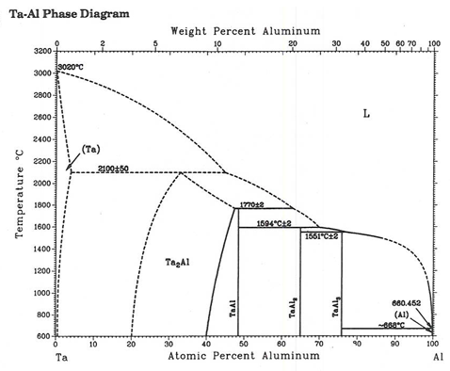
Tantalum Aluminides Background
Tantalum Aluminides Represent a ‘model’ Material for the Army and Nuclear Reactors
Equilibrium Phase Relations
Four intermetallics:
Ta₂Al T_{m}=2,100C;
TaAl T_{m}=1,770C;
TaAl₂ T_{m}=1,594C;
TaAl₃ T_{m}=1,551C;

Slide 7
Hot Explosive Compaction
The Technique
Step 1:
Sample were consolidated at room temperatures to increase their predensity and to activate consolidating particles surfaces.
Step 2:
Prelimionary predensified billets were reloaded second time at 940Cº with intensity of compression under 10GPa.
Advantages/Disadvantages:
Requires less energy and no further sintering processing is necessary

Slide 8
Scale-Up
Motivation
The blends of coarse Ta-Al and Ta-Al-B4C with dimension around 5-10µm and B4C were used in experiments.
Subsequent experiments provided obtaining billets with dimensions 15mm × 50mm.
(Ta-50Al wt.%)-20B4Cwt%;
Al size = 5 µm
(Ta- 25Al) wt.%;)- 20B4Cwt%;
Al &Ta size = 5 µm;
B4C size=10 µm

Slide 9
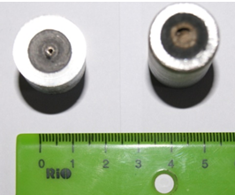
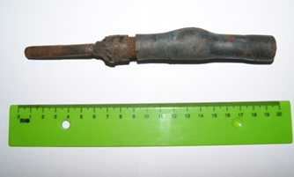
Predensification of Ta-Al before HEC
a) b)
View of Predensified Billets at Room Temperatures
a)Ta-Al powder blend after consolidation at room
temperature;
The Partial SHS reaction observed in the center of sample;
b) Ta-Al-B4C billet after heating at 940˚C before HEC.

Slide 10
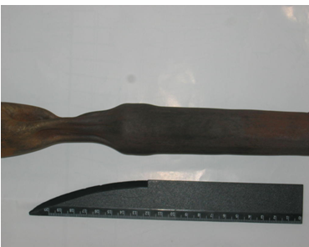
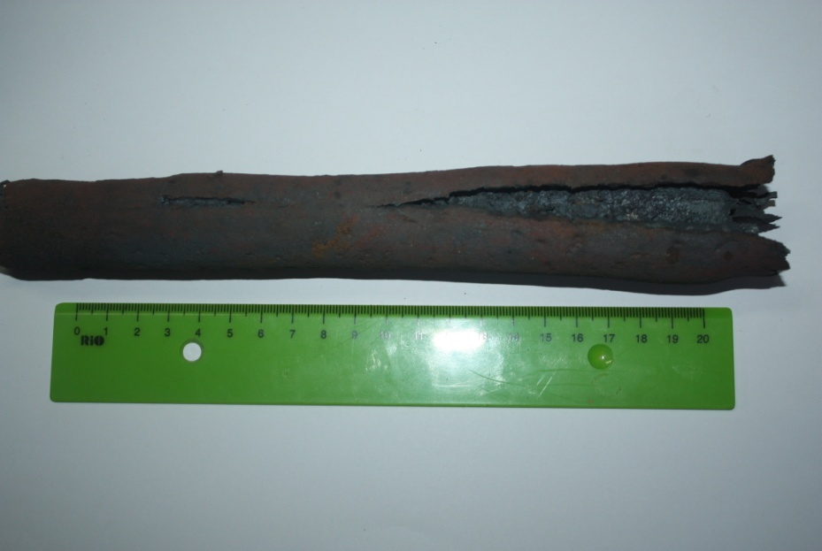
HEC of Ta-Al Based Blend Powders
a) b)
HEC of Ta-Al based precursors at 940˚C with post SHS process.
a) TaAl-20%B4C composite; b) TaAl3 composites.

Slide 11
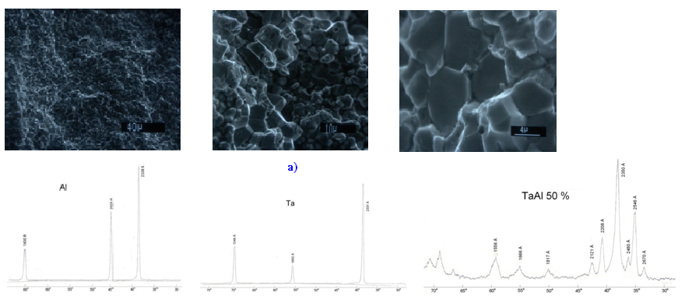
Microstructure and X-ray Analyses of HEC TaAl composites
b)
The Microstructures of HEC TaAl intermetalics at 920˚C with post SHS process.
Microstructures at different magnifications;
b) X-ray diffraction picture of precursors and after HEC.

Slide 12
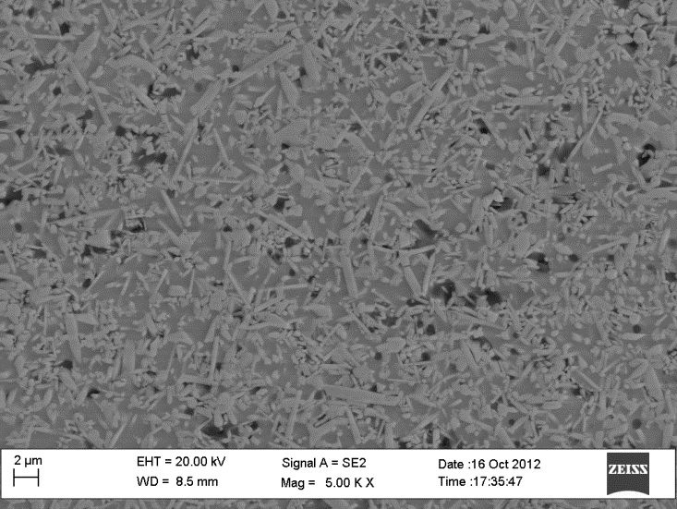
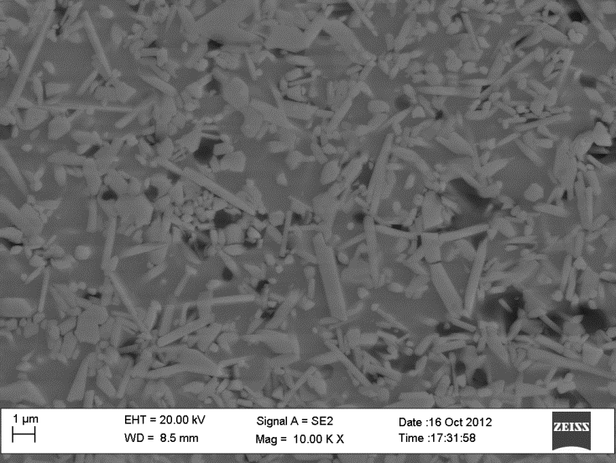
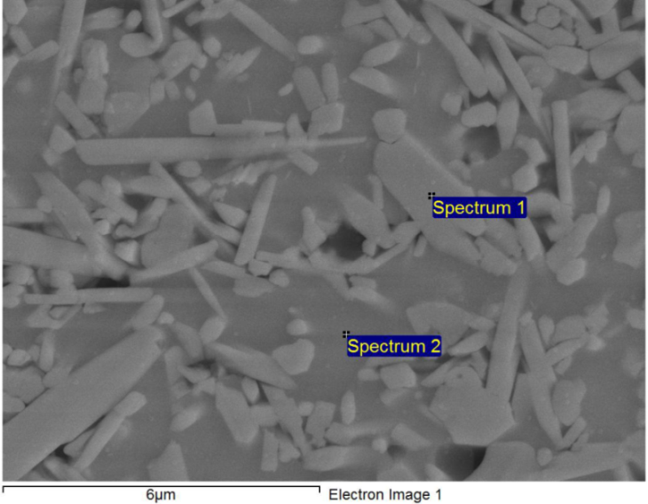
Microstructure and Phase Distribution of HEC TaAl-20%B4C Precursors
option : All elements Processing analysed Spectrum In stats.
B C O Al Ta
Spct.1 Yes 46.94 12.84 3.64 0.37 36.20
Spct.2 Yes 9.60 2.08 61.16 27.15
Max. 46.94 12.84 3.64 61.16 36.20
Min. 46.94 9.60 2.08 0.37 27.15
Sharp phase separation was detected using SEM-assisted energy dispersive X-ray spectroscopic (EDS) analysis.

Slide 13
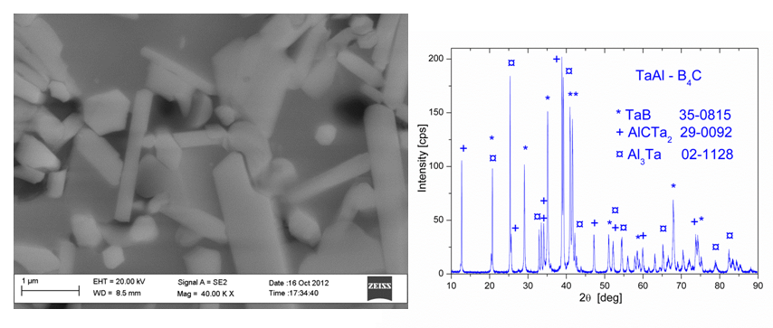
Microstructure and X-ray Diffraction Picture of HEC TaAl-20%B4C Precursors
There is a wide distribution of the grain size: from about 5 μm to the submicron scale of 200 nm.
Right figure shows θ-2θ scan made in a standard Bragg-Brentano geometry. All the Bragg reflections were identified as TaB, AlCTa2, and Al3Ta phases, based on the JCPDS–International Center for Diffraction Data, Cards No. 35-0815 (TaB), 29-0092 (AlCTa2), and 02-1128 (Al3Ta) (JCPDS–International Center for Diffraction Data, 2001).

Slide 14
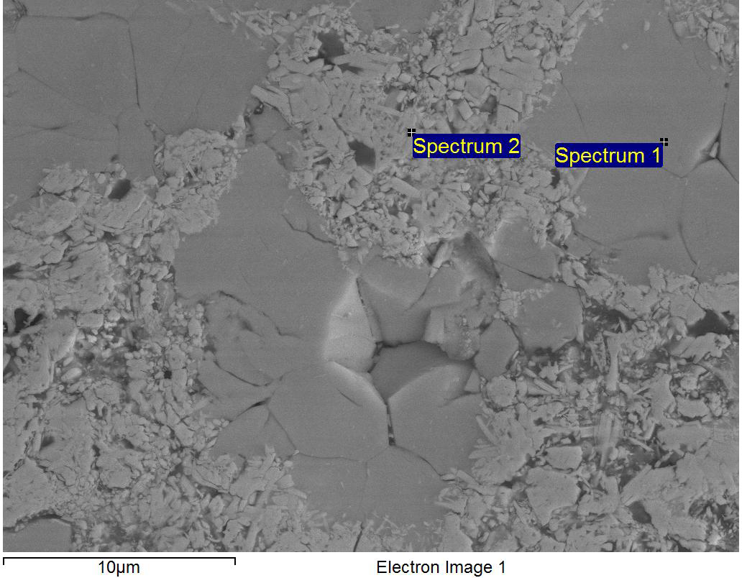
Microstructure and Phase Distribution of HEC TaAl-20%B4C Precursors
SEM image and EDS of the peripheral area of the specimen is shown in Fig. Two different types of grains manifest themselves. They are big size and mixture of highly dispersed sized grains, respectively, mostly Al3Ta (spectrum 1) and mixture of TaB and AlCTa2 (spectrum 2).
Processing option : All elements analysed Spectrum In stats.
B C O Al Fe Ta
Spct.1Yes 13.78 9.68 2.24 53.31 20.99
Spct.2Yes 30.99 24.90 6.25 11.00 1.41 25.44
Max. 30.99 24.90 6.25 53.31 1.41 25.44
Min. 13.78 9.68 2.24 11.00 1.41 20.99

Slide 15
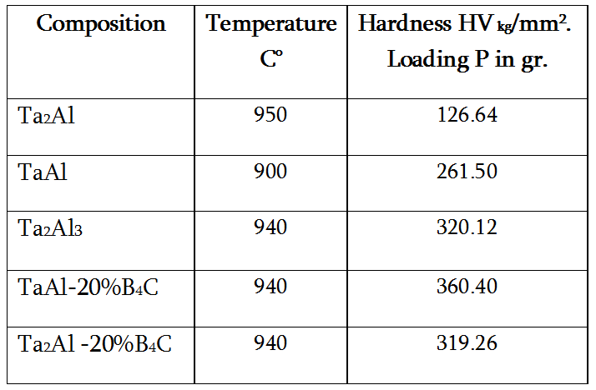
Distribution of Hardness in HEC Samples Depending on Phase Content

Slide 16
Ta-Al HEC Billets. Discussion.
Previous results connected with HEC Ni-Al and Ti-Al composites, the current application of HEC to Ta-Al composites seems to be promising. It was shown in our previous work that application of high temperatures and HEC of composites of Ni(Ti)-Al could not fully result in intermetallic compounds. HEC of Ni-Al composites at 1000 Cº in spite of having good density and correct geometry provided only, resulted only partially of intermetallic compounds of Ni-Al composites.
Analyzing the situation of the formation of intermetallics it was concluded that the reason is low intensity of compression due to low pre-density of the HEC precursors.
The use of Ta-Al precursors seems to be more promising, from the standpoint of features of explosive consolidation processes and formation of intermetallic compounds. This is the high density of Ta powder (16.4 g/cm³) and the high reactivity of Ta-Al system. Application of HEC technology may be solved previously fixed problems, based on developed of high intensity of compression (loading) and high consolidation needed for initiation of SHS processes during heating.

Slide 17
Ta-Al HEC Billets
Discussion
Results of the X-ray investigation show that in contrast to pure Ta & Al diffraction of the precursors, the Ta-Al HEC samples have different phase content. It is difficult to recognize and identify the pure Ta and Al phases.
The appearance of new lines of TaAl composites indicates that there were chemical reactions and intermetallic compounds formed.

Slide 18
Concluding Remarks
Established that SHS reaction in Ta-Al predensified composites starts at 940⁰C with further full transformation into the tantalum aluminades. The type of obtained intermetalic compounds (Ta2al, TaAl or TaAl3) depend from weight proportion of Al and Ta in the precursors.
Established that by combination of HEC and SHS processes it’s possible to consolidate bulk intermetalic compounds near theoretical density with perfect structure and good strength. In order to prevent cracking it’s recommended to HEC Ta-Al billets before SHS temperature under 940⁰C with further SHS reaction .
There is investigated influence of passive B4C additive role on the HEC and SHS process and formation of intermetalic compounds. It was established HEC with post SHS reaction in preliminary denisfied Ta-50%Al-20%B4C powder blends leads to full dissolution of B4C and redistribution of consisting B and C phases into the reactant components with further formation of new TaB and Ta2AlC phases.

Slide 19


Future Work
To continue investigation in wide range of Ta/Al ratio and additional B4C phase content.
Improve particle size and to fabricate Ta-Al-B4C composites based on nanoscale precursors.

Slide 20

Thank you for Your Attention
Questions

